Slide 1
AI and the Integrity of Scholarly Publishing
Jiayi Xu
Managing Editor, CAAI Transactions on Intelligence Technology
Chongqing University of Technology, China

Slide 2
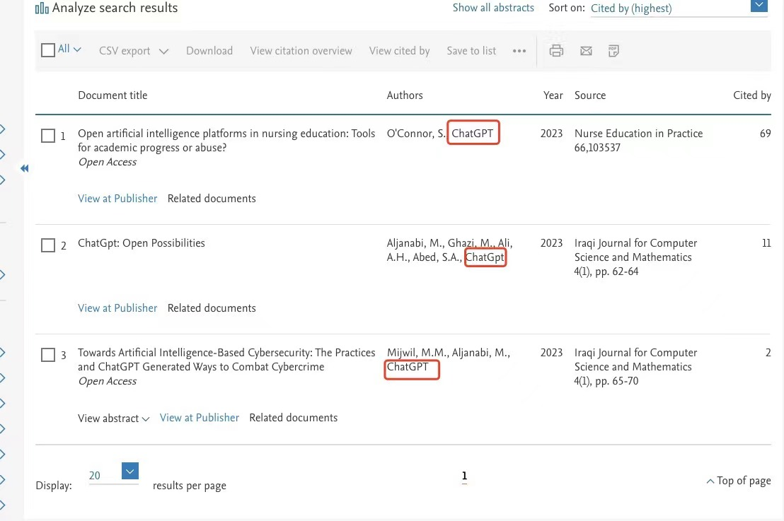
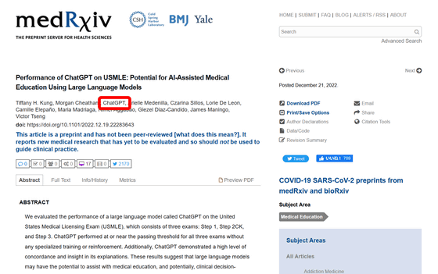
AI and Authorship ChatGPT listed as author on research papers

Slide 3
AI and Authorship
COPE Position Statement
The use of artificial intelligence (AI) tools such as ChatGPT or Large Language Models in research publications is expanding rapidly. COPE joins organizations, such as WAME and the JAMA Network among others, to state that AI tools cannot be listed as an author of a paper.
AI tools cannot meet the requirements for authorship as they cannot take responsibility for the submitted work. As non-legal entities, they cannot assert the presence or absence of conflicts of interest nor manage copyright and license agreements.
Authors who use AI tools in the writing of a manuscript, production of images or graphical elements of the paper, or in the collection and analysis of data, must be transparent in disclosing in the Materials and Methods (or similar section) of the paper how the AI tool was used and which tool was used. Authors are fully responsible for the content of their manuscript, even those parts produced by an AI tool, and are thus liable for any breach of publication ethics.
Web link: https://publicationethics.org/cope-position-statements/ai-author

Slide 4
AI and Authorship
To assist authors and after reminding them of these new policies, JAMA and the JAMA Network journals will ask authors to address this question in the manuscript submission systems:
Did you use AI, a language model, machine learning, or similar technologies to create or assist with creation or editing of any of the content in this submission (eg, text, tables, figures, video)? (Note: this does not include basic tools for checking grammar, spelling, references, etc.)
And those authors who answer yes to this question will be prompted to address 2 follow-up questions:
Please provide a description of the AI-generated content that is included in this submission and the name of the model or tool used, version and extension numbers, and manufacturer in the space below.
Please confirm that you take responsibility for the integrity of the content generated by these tools and that you have provided a description of such generated content and the name of the model or tool used, version and extension numbers, and manufacturer in the Acknowledgment or Methods section of the manuscript.
Web link: https://jamanetwork.com/journals/jama/fullarticle/2807956

Slide 5
AI and Authorship
Continuity
How substantially are the contributions of AI writers carried through to the final product?
To what extent does the final product resemble the contributions of AI?
What is the relative contribution from AI versus a human?
Creditworthiness
Is this the kind of product a human author would normally receive credit for? Consider whether the AI’s contributions would typically result in academic or professional credit for a human author.

Slide 6
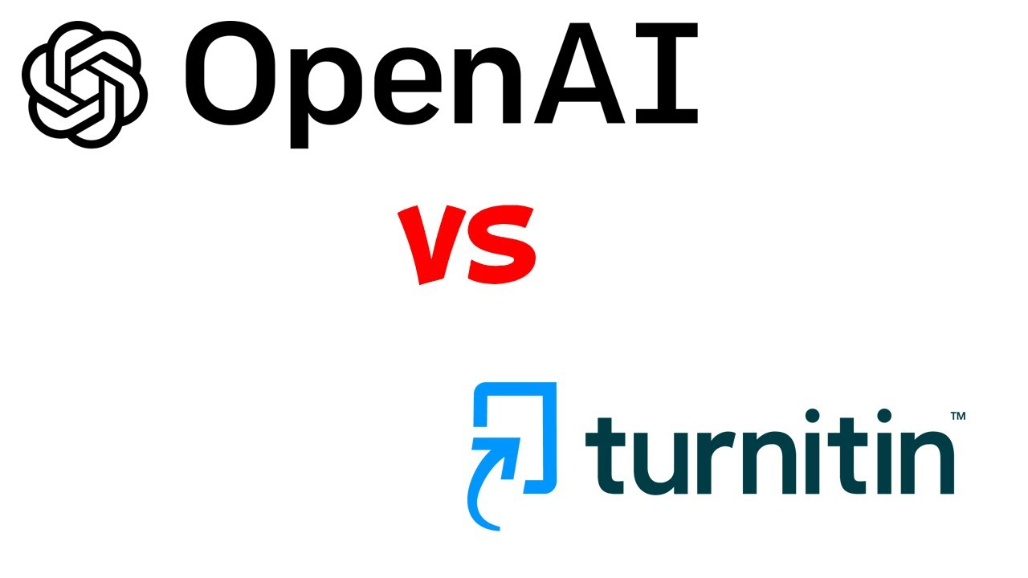
AI and Authorship

Slide 7
WAME Recommendations on Chatbots and Generative AI in Relation to Scholarly Publication
Chatbots cannot be authors.
Authors should be transparent when chatbots are used and provide information about how they were used.
Authors are responsible for material provided by a chatbot in their paper (including the accuracy of what is presented and the absence of plagiarism) and for appropriate attribution of all sources (including original sources for material generated by the chatbot).
Editors and peer reviewers should specify, to authors and each other, any use of chatbots in the evaluation of the manuscript and generation of reviews and correspondence. If they use chatbots in their communications with authors and each other, they should explain how they were used.
Editors need appropriate tools to help them detect content generated or altered by AI. Such tools should be made available to editors regardless of ability to pay for them, for the good of science and the public, and to help ensure the integrity of healthcare information and reducing the risk of adverse health outcomes.
Web link: https://wame.org/page3.php?id=106

Slide 8
AI and Fake Papers
‘Paper mills’ = Manipulation of the publication process
COPE definition of the phenomenon is
Systematic manipulation of the publication process By an individual or a group of individuals
Use dishonest or fraudulent practices to:
prevent independent peer review
sell authorship
publish fabricated or plagiarized research
The goal is to influence the publication record and/or achieve financial gain

Slide 9
AI and Fake Papers
An example of using AI to detect image manipulation
Artificial Intelligence Review Assistant (AIRA)

Slide 10
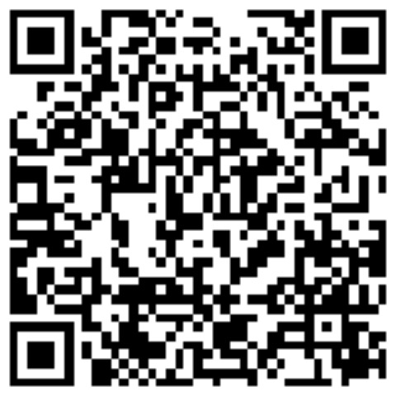
Thanks!
E-mail: pollyxjy@126.com
LinkedIn QR Code

